Slide 1

Introduction To AI Even Semester Session 2025-26
AI Chatbot using Transformers
Shashank Singh, Tarun Kumar, Ved Teotia, Vishal Dagar
Project Supervisor:
Supervisor Name: Mr. Apoorv Jain
Designation: Assistant Professor

Slide 2





Presentation Agenda
Understanding Transformers
Delve into the architecture that powers modern AI language models.
Python & Hugging Face
Leverage key libraries for seamless model integration.
Chatbot Development
Step-by-step guide to building your conversational agent.
Training & Evaluation
Optimize performance and assess model effectiveness.

Slide 3
What are Transformer Models?
Transformer models are neural networks designed to process sequential data, particularly natural language. They revolutionized NLP with their attention mechanisms, allowing parallel processing and long-range dependency capture.
Attention Mechanism
Encoder-Decoder Architecture
Focuses on relevant parts of the input sequence.
Comprises an encoder for input understanding and a decoder for output generation.
Self-attention computes relevance within a sequence.
Cross-attention connects encoder and decoder outputs.
Encoder processes input tokens.
Decoder generates output tokens sequentially.

Slide 4
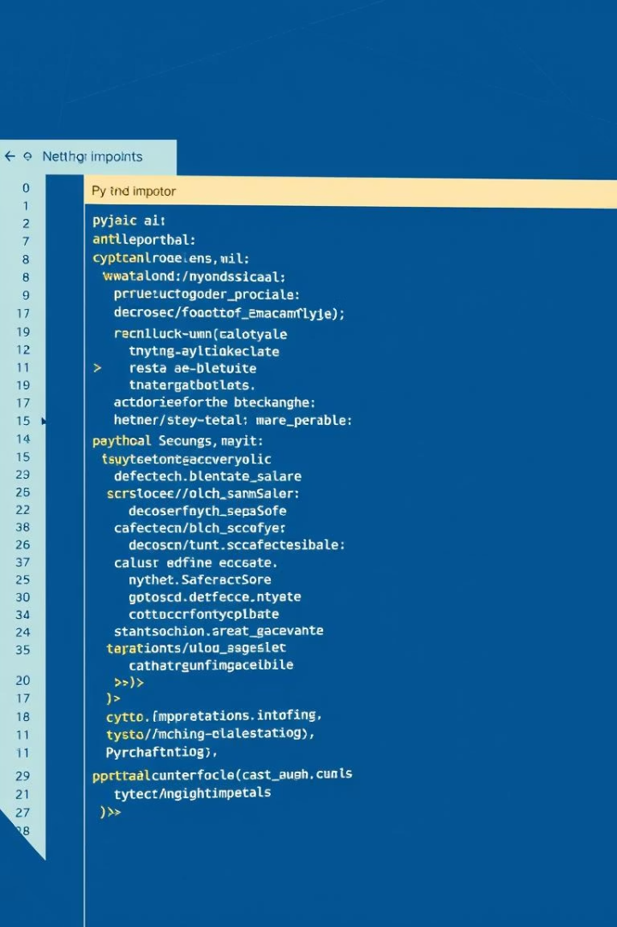
Key Python Libraries
Building AI chatbots in Python is made easier with robust libraries. Hugging Face Transformers is central, offering pre-trained models and easy-to-use APIs. PyTorch and TensorFlow provide foundational deep learning capabilities.
Hugging Face Transformers
PyTorch / TensorFlow
Deep learning frameworks for building and training neural networks efficiently.
Access a vast collection of pre-trained transformer models and tools for fine-tuning.
NLTK / SpaCy
Natural Language Toolkit and SpaCy are used for text preprocessing and analysis.

Slide 5
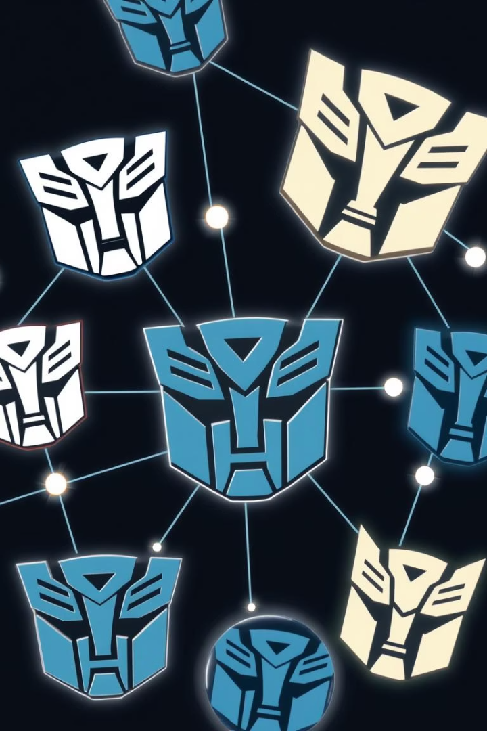



Choosing a Transformer Model
Selecting the right pre-trained model is crucial. BERT is excellent for understanding text, while GPT-2 and GPT-3 are powerful for text generation. T5 handles various tasks through a text-to-text format.
BERT
GPT-2/GPT-3
T5
Bidirectional Encoder Representations from Transformers, ideal for understanding context.
Generative Pre-trained Transformers, highly effective for coherent text generation.
Text-to-Text Transfer Transformer, good for multiple NLP tasks like summarization.

Slide 6








Data Preparation for Chatbots
High-quality data is essential for a well-performing chatbot. This involves collecting relevant conversation data, cleaning it, and tokenizing it into a format suitable for transformer models. Data diversity is key.
Data Cleaning
Data Collection
Remove noise, duplicates, and irrelevant information.
Gather diverse conversational data sets.
Dataset Formatting
Tokenization
Structure data appropriately for training and validation.
Convert text into numerical tokens for model input.

Slide 7
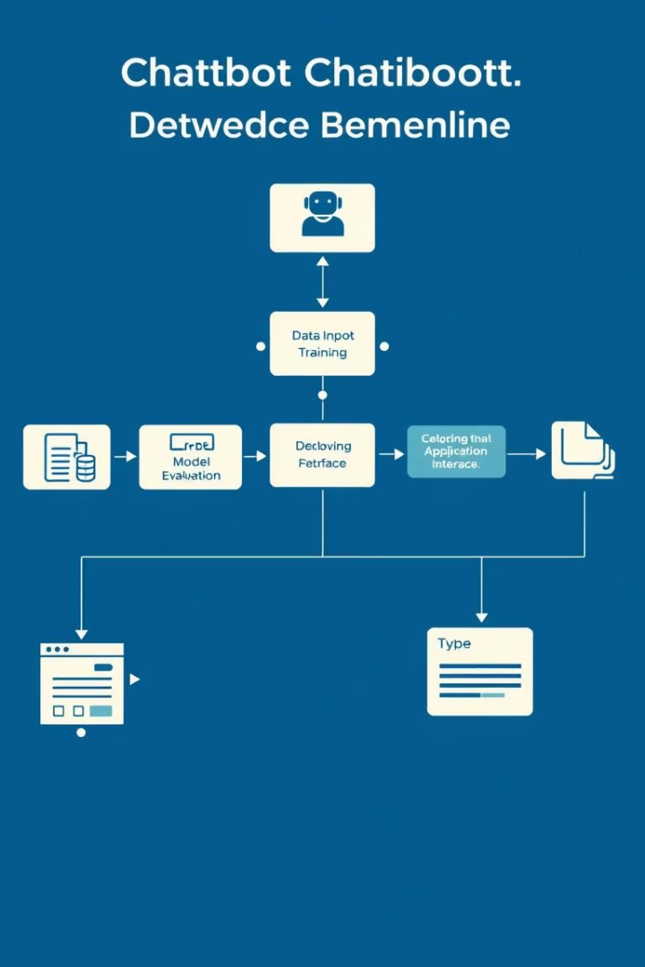




Building the Chatbot: Key Steps
The development process involves loading a pre-trained model, fine-tuning it with your specific dataset, and then deploying it. User feedback helps refine the model over time, ensuring continuous improvement.
Load Pre-trained Model
Utilize Hugging Face's `AutoModelForCausalLM` or `AutoModelForSeq2Seq`.
Fine-tune on Custom Data
Train the model with your prepared conversational dataset.
Deploy & Test
Integrate the model into an application and perform testing.
Iterate & Improve
Collect user feedback and retrain for better performance.

Slide 8
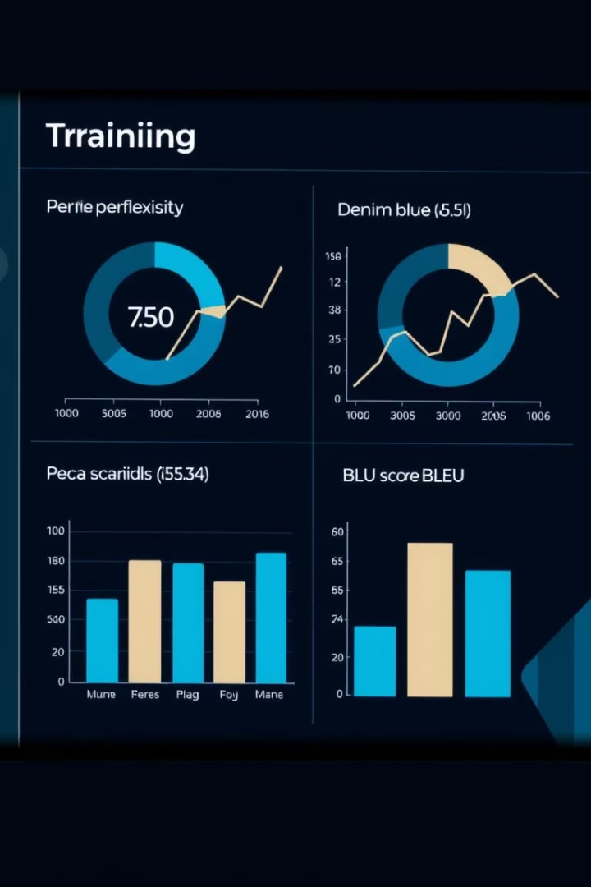
Training and Evaluation Metrics
Monitoring training progress with metrics like perplexity and BLEU score is vital. Perplexity measures how well the model predicts new text. BLEU score assesses the quality of generated text against human references. Accuracy and F1-score are also relevant.
<100
>0.5
Perplexity
BLEU Score
Lower is better for fluent text generation.
Higher indicates better translation/generation quality.
>0.8
Accuracy
Measures correct predictions for classification tasks.

Slide 9
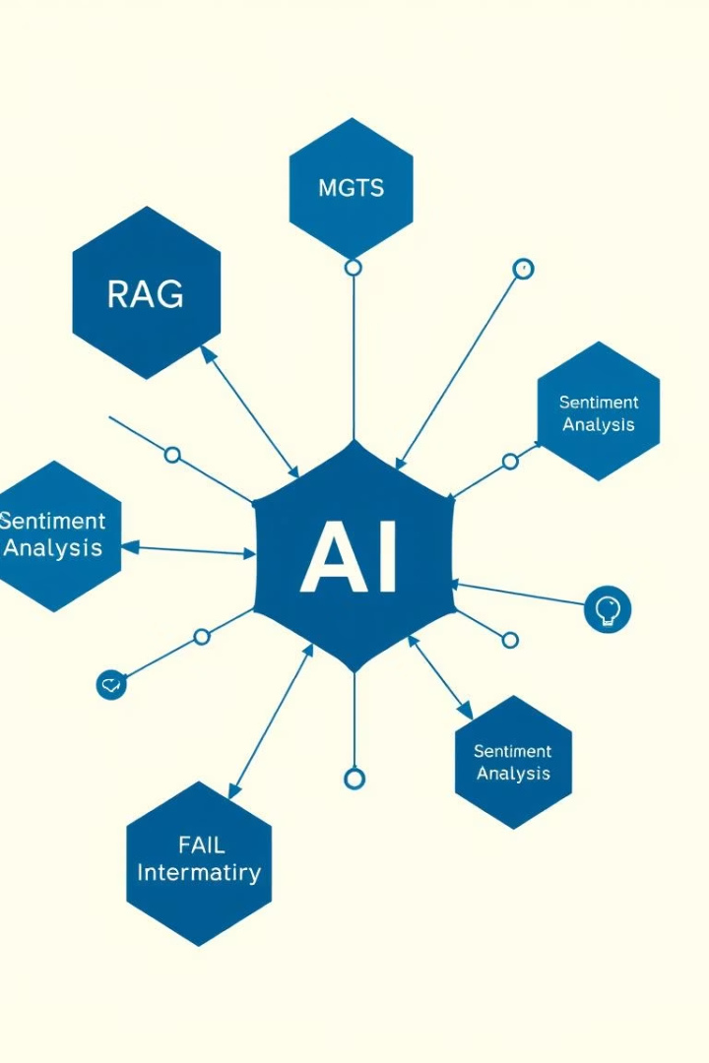
Advanced Chatbot Features
Enhance your chatbot with advanced capabilities. Incorporate retrieval-augmented generation (RAG) for factual accuracy. Implement sentiment analysis to understand user emotion. Add knowledge graphs for structured data interaction, and use few-shot learning for rapid adaptation.
Retrieval-Augmented Generation (RAG)
Combine retrieval systems with generative models for grounded responses.
Sentiment Analysis
Understand and respond to the emotional tone of user inputs.
Knowledge Graphs
Integrate structured information for more informed conversations.
Few-Shot Learning
Enable rapid adaptation to new tasks with minimal examples.

Slide 10



Key Takeaways & Next Steps
Transformer models offer powerful capabilities for AI chatbots. Python with Hugging Face simplifies development. Continuous iteration and advanced features lead to sophisticated conversational AI. Explore open-source models and contribute to the community.
Continue learning by experimenting with different models and datasets. The AI community is growing, and your contributions can help advance the field.

